Slide 1
Environment Setup
Set java path and class path
Banu Priya.S
Developer,
Glabs,
TVR

Slide 2



Environment Setup
Set java path and class path
How to set path in java?
Don’t know sir

Slide 3
Environment Setup
Set java path and class path
See this video:https://www.youtube.com/embed/oowsJcJLmss
See the document:https://www.sitesbay.com/java/java-classpath-setting
K sure I see this video

Slide 4
Environment Setup
Set java path and class path
Ya tell me
Sir I have one doubt sir
What is JVM,JDK.JRE?

Slide 5
Environment Setup
Set java path and class path
See this video:https://www.youtube.com/embed/RYd_hagCiVk
See the document:https://www.sitesbay.com/java/jdk-jvm-jre
And See the image
K sure I see this video

Slide 6
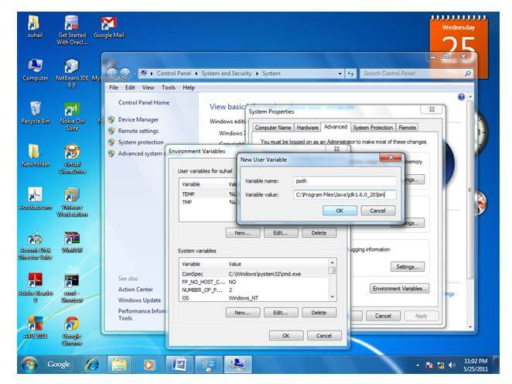

Slide 7
Playlist
set path video:
https://www.youtube.com/embed/oowsJcJLmss
JDK ,JRE,JVM VIDEO :
https://www.youtube.com/embed/RYd_hagCiVk

Slide 8
THANK YOU

